Slide 1
Research Project 4.23 Report
Group Members:
Junchao Wang, Yingnan Zhao, Qingfeng Xu

Slide 2
Part 1 Research Proposal

Slide 3
Title: Using single Q funtion to against multiple reward function in deceptive reinforcement learning

Slide 4
Content
Abstract
Introduction
Background of the study
Problem statement
Research Objective
Significance of the study
Literature Review
Research Methodology
Justification
Plan
Expected Outcomes

Slide 5
Introduction
Background of the study
Reinforcement learning (General theory and application)
Deception reinforcement learning (objective and evaluation)
Problem Statement
A reinforcement learning path planning problem P
A root agent A knows the whole goals, map and reward functions of problem P.
A deceptive path planer agent A’
The observers O
The root agent A generates a Q-Table T to provide for deceptive path planer A’A’design a deceptive path based on T and show the path observer O, which let O cannot discriminate the real goals according to the path.

Slide 6
Introduction
Research Objective
Design single Q-function which integrated all reward functions
Only one agent who is dealing with this single Q-function knows the truth
Privacy of the whole system can be protected in a safer way
Significance of the study
Finish one of the sub-topic of deception reinforcement learning.

Slide 7
Literature Review
Deception general theory (Barton Whalty)
Deception reinforcement learning (Yue Yang, Zhengshang Liu, Peta Master and Tim Miller, ).
Designing a deceptive path (Peta Masters and Sebastian Sardina)
Interaction model which deals with multiple reward function and goals (Gouglas M. Guisi)

Slide 8
Research Methodology
Mathematical Proof
To acquire a correct and rational Q-Value after covering multiple reward functions in a single Q function
How this model performs on deception reinforcement learning well
Experiments by coding and testing
Experiment on P4-simulator
Verifying the performance of the integrated Q table

Slide 9
Plan
Time | Work
3.2-3.9 | research the basic knowledge of deception reinforcement learning
3.10-3.24 | we reproduce the models that show in popular paper and decided the specific research topic
3.25-4.8 | Basic on our topic to de relative research
4.9-4.23 | we start to implement that using a single updating function against multiple reward functions.
4.24-5.1 | Collect experiment results and decided the final methods
5.1-5.7 | we optimize the performance on various situations and test the result
From 5.7 | we organize the final results and write report

Slide 10
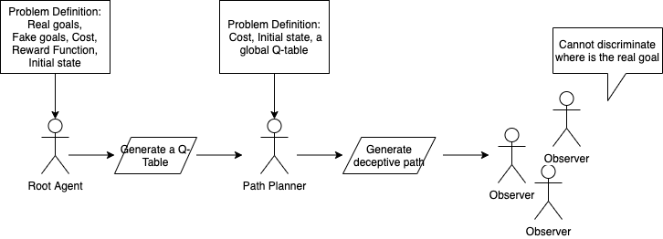
Expected Outcomes

Slide 11
Part 2 Current Project State

Slide 12
Finished Work
Generate Best Path According to a single Q-table

Slide 13
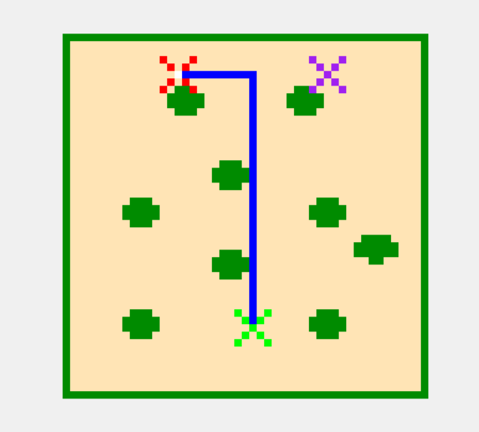
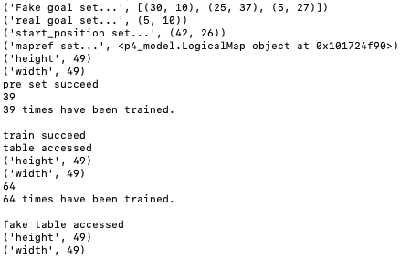
Work Result
We train Q table with fake goal and real goal separately, and then integrate to be one table.
Optimal Path Planning according to a single Q-Table

Slide 14
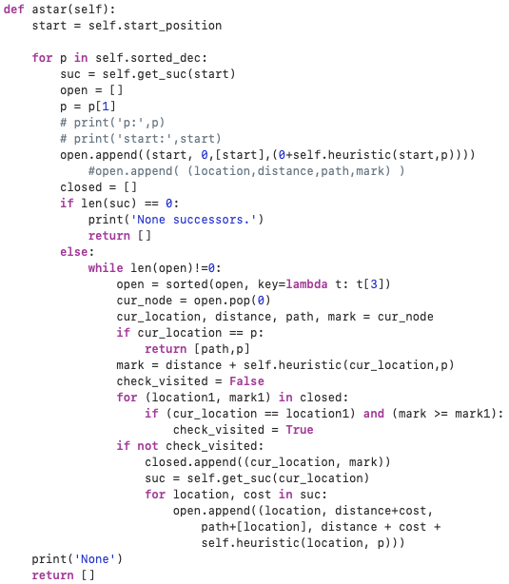
self.q_table[width][hight][action_number]
The final Q-Table comes to be a Width*Hight*Action_Number metrix.
Then we use Astar to generate an optimal path
But this is also the current problem!

Slide 15
Part 3 Problems and Assumptions

Slide 16
Problem
Currently the method of integrating different reward function as a single Q-table is adding various result together. However, more methods can be applied. For example, the paper Interaction model which deals with multiple reward function and goals (Gouglas M. Guisi)
Currently we do not have a good solution to use a single Q-Table to design deceptive path. Since both popular models ambiguity model and irrational models based on the reward function and related Q-Value.
But we have some assumptive methods which will be tested later.

Slide 17

Assumption A: Models Transformation
We can transform the irrationality model or ambiguity model to be a new model that can only use single Q-table to generate deceptive path. For example, irrationality model
Here we need using reward function to compute irrationality measure
We can replace the measurement by computing the Q-value of serval key points such as the largest Q-value and the sub-largest Q-value
https://piazza.com/class_profile/get_resource/k440kkcj3o9516/k74k4sal74n4fw

Slide 18
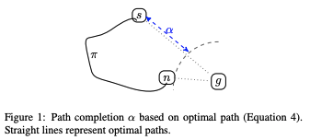
Assumption B: The radius of maximum probability
We assign every point on the map with a probability of going to real goal at the beginning of the problem. If the probability is high, the observer may think this point is going to a goal.
On the one hand, we avoid to go to the points that have the high probability to go to a real goal, on the other hand, we reduce the cost of the path.
https://www.ijcai.org/Proceedings/2017/0610.pdf
However, it is hard to integrate this method with Q-Value!

Slide 19
Assumption C: Using Entropy
This method is basing on Assumption B. Rather than using maximum probability, we use entropy to measure the performance of the agent.

Slide 20
Thank You

